Slide 1
AWS Lambda

Slide 2
Serverless Functions
Serverless functions are cloud computing functions that allow developers to write and deploy code without managing the underlying infrastructure.
In a serverless architecture, the cloud provider manages the servers and allocates resources on demand.

Slide 3
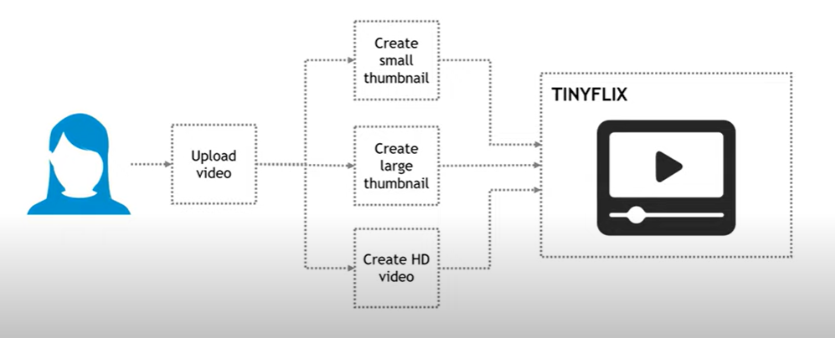
AWS Lambda

Slide 4
Steps
Create the Spring Boot project.
Create the Lambda function in AWS Console.
Create API Gateway for the Lambda function.
Trigger Lambda from SQS

Slide 5
Create the Spring Boot project.
First create a maven project in eclipse.
Choose archetype as serverless-springboot3 and generate the project.
Now we have a proxified spring boot application.
Next create the endpoints required.
Then build the project use maven clean install.

Slide 6
2. Create the Lambda function in AWS Console.
Next go to the AWS Lambda Console.
Create a Lambda function.
Upload the zip file of the previously built project.
Before testing the Lambda, we have to edit the default handler method.
Under Handler click edit and enter
com.demo.spring_lambda_vehicle_demo.StreamLambdaHandler::handleRequest
And click save.
Next choose the template as apigateway-aws-proxy and edit path and httpmethod.
Now click on Test and we should see that the get endpoint of the url has been called.

Slide 7
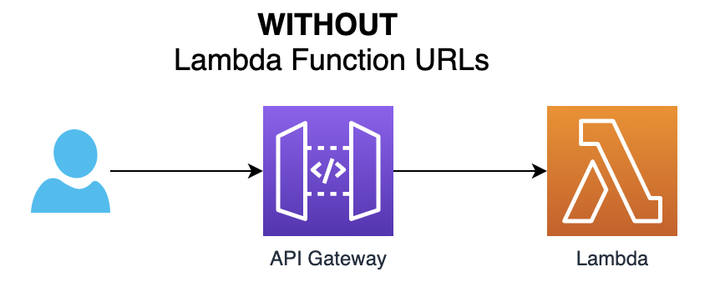
3. Create API Gateway for the Lambda function.

Slide 8
3. Create API Gateway for the Lambda function.
Go to API Gateway and create an API.
Choose REST API.
Choose Regional and click Create API.
Now click on / and click on create resource.
Under Resource Name provide {proxy+} and click create.
Then click on Create Method and choose ANY and save it.
Next stage it.
Next copy the invoke url after clicking the /
Now paste the url in postman and then add our url api/vehicles.
Now test the endpoint in postman to see the desired output.

Slide 9
Further explore
Try to trigger the lambda from a SQS.

Slide 10
END

